Slide 1

Lab 2
Shell Scripting!

Slide 2
See this file over here!
student_details.csv

Slide 3
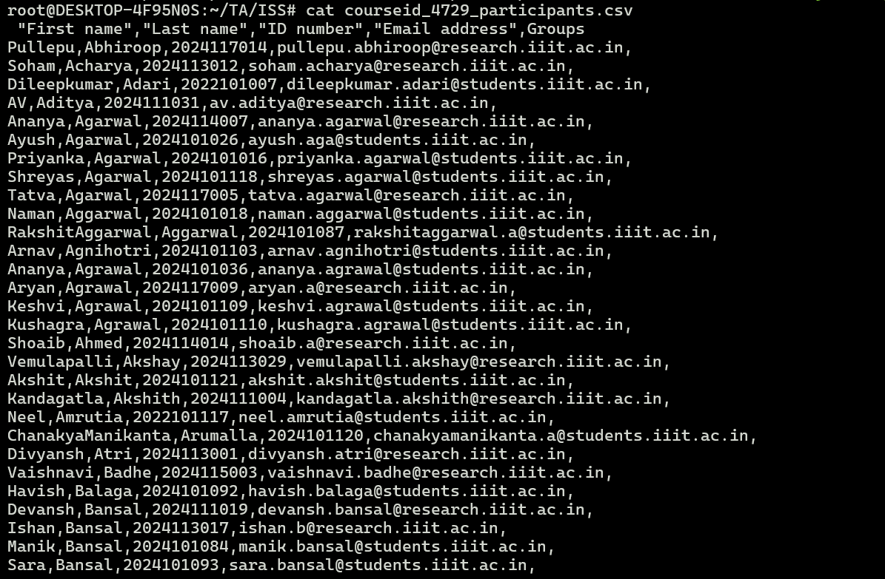

Slide 4
Do you see a problem in the file?
student_details.txt

Slide 6
The TAs are imposters in this list! What can we do about that?
What is the main difference between the TAs and the students in this case?
Notes:
What is common in the TAs?

Slide 7
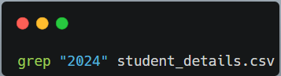
How do we filter based on the Roll No.?
The answer would come here
Notes:
What is common in the TAs?

Slide 8

Let’s come to certain real life use cases of grep!
Credits: @naughty_iiith_confession_page
Notes:
This is important – please pay attention

Slide 9

Let’s come to certain real life use cases of grep
Credits: @naughty_iiith_confession_page

Slide 10
What if we want just the names from the file student_details.csv (no email id, roll no., etc.)

Slide 11
We are trying to get the first and the second columns here

Slide 12

Welcome awk!

Slide 13
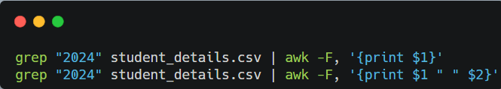

Slide 14
Suppose we want to change the commas to spaces

Slide 15
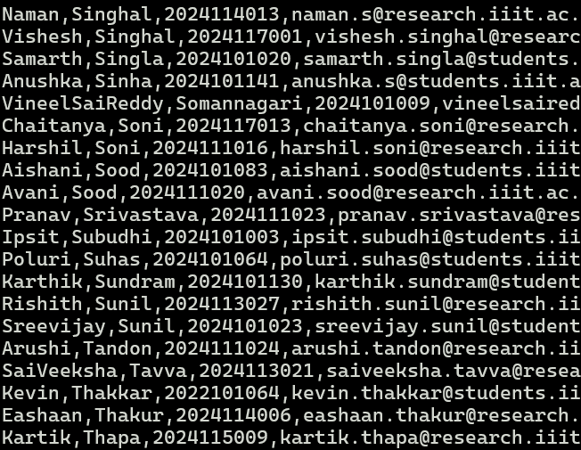
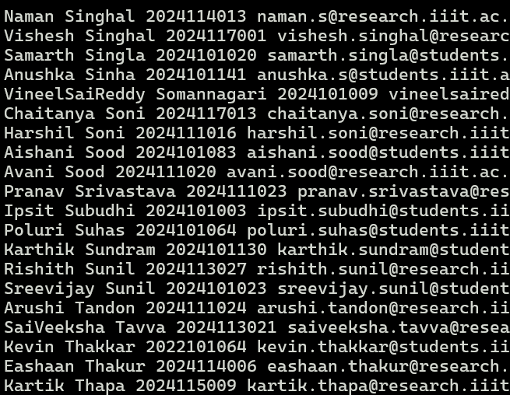

Slide 16
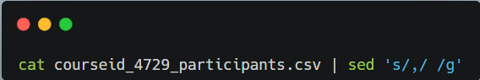

Slide 17


Slide 18
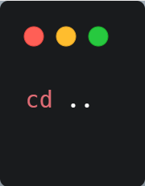
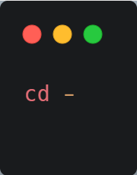
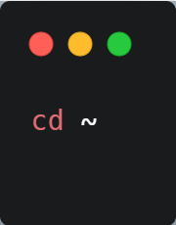
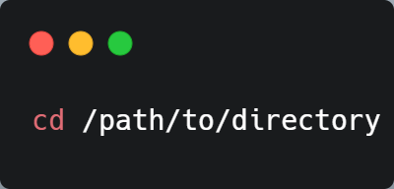
File management using bash (cd)

Slide 19
File management using bash (cd)
Absolute path
Relative path
Previous Path
Home dir

Slide 20
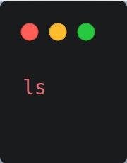
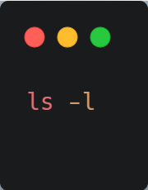
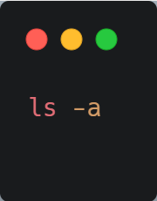
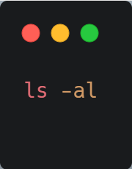
File management using bash (ls)

Slide 21
File management using bash (ls)
List files
List with more information
List all files (including hidden)
Combination of all files and verbose.

Slide 22
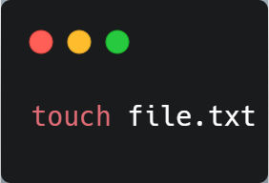
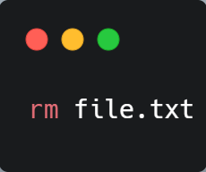
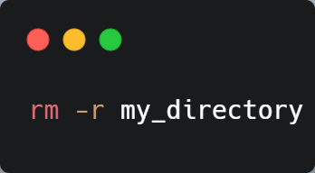
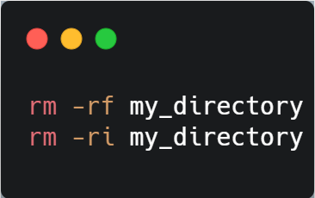
File management using bash

Slide 23
File management using bash
Create new file / change date
Remove file
Recursively remove all files and dir
Force/ prompting

Slide 24
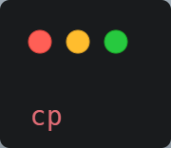

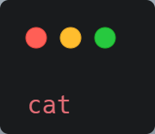


File management using bash
Notes:
Cat = concatenate, do recursive options too

Slide 25
File management using bash
Copy
Move / Rename
File Viewing
Notes:
Cat = concatenate, do recursive options too

Slide 26
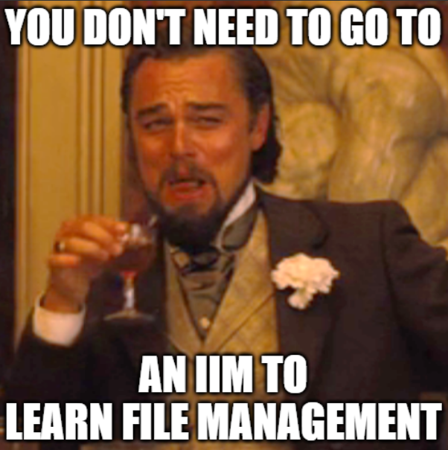
© Ansh Chablani

Slide 27
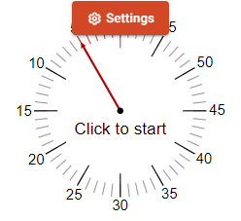
A fun activity!
Using just grep and one out of (cd, ls, cp, mv), find all the files in the current directory that have .txt in the name.

Slide 28
See, you already know how to find something somewhere!

Slide 29
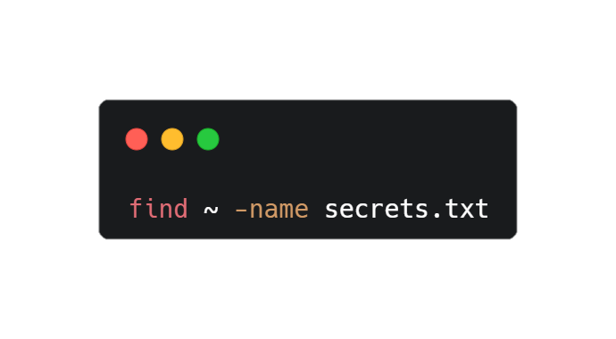
But there is more that you can do!
The find command!
Notes:
Give an introduction by switching to the terminal. Then come back

Slide 30
Ways to search using the find command
Have a look in the terminal.
Notes:
Switch to terminal after showing this slide.

Slide 31

Find is slow, isn’t it?
Please welcome the locate command.

Slide 32
The locate command searches the File System Database (FSDB) and is hence faster
‘
’

Slide 33
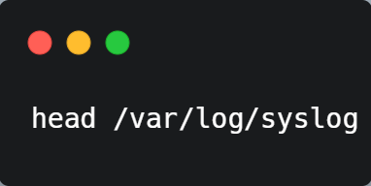
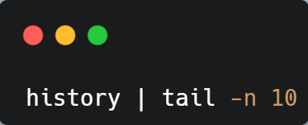
Head and Tail commands
Notes:
Switch to terminal

Slide 34
Arrays

Slide 35
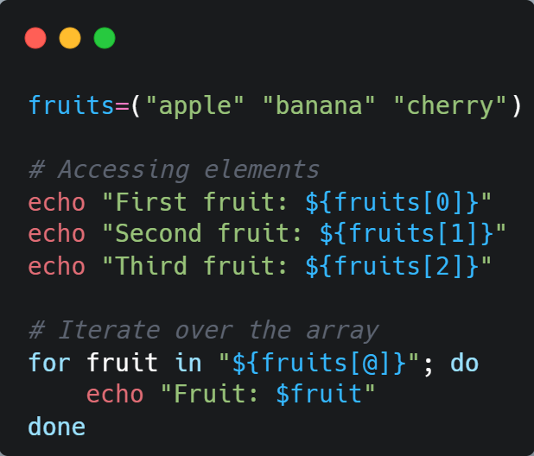

Slide 36
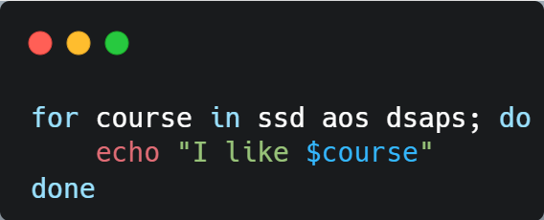
Loops

Slide 37
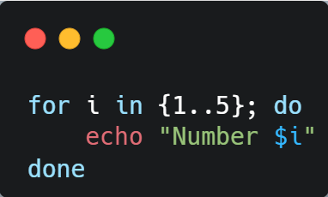
Iterating over Numbers

Slide 38
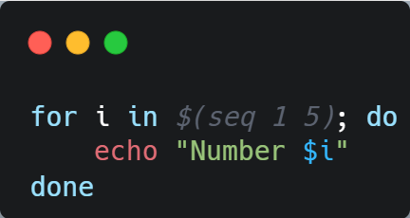
Using seq for range

Slide 39
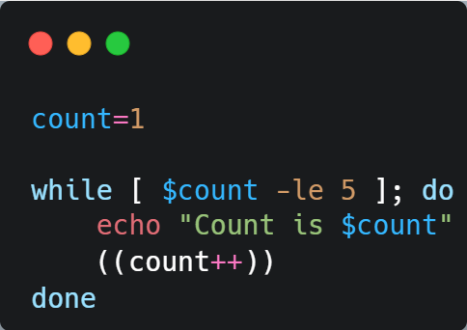
The while loop

Slide 40
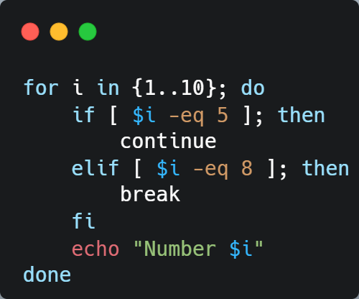
Using break and continue
What would be the output of this code?
(Open the linktree and attempt the quiz)

Slide 41
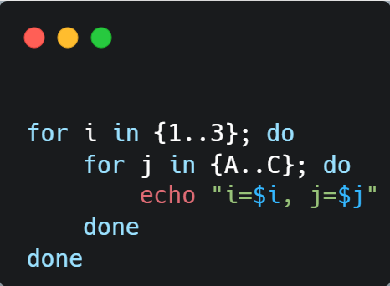
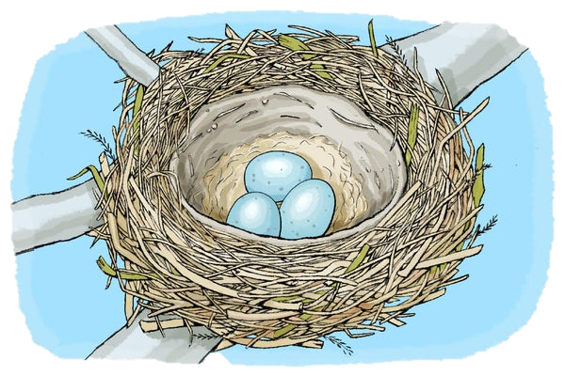
Nested Loops

Slide 42
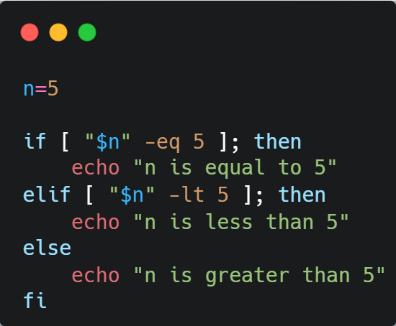
Conditionals

Slide 43
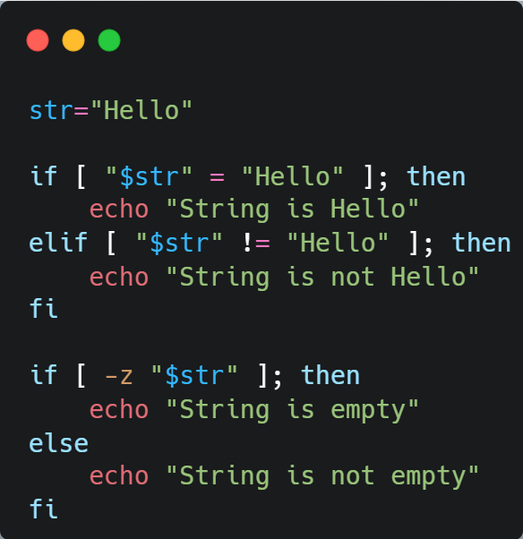
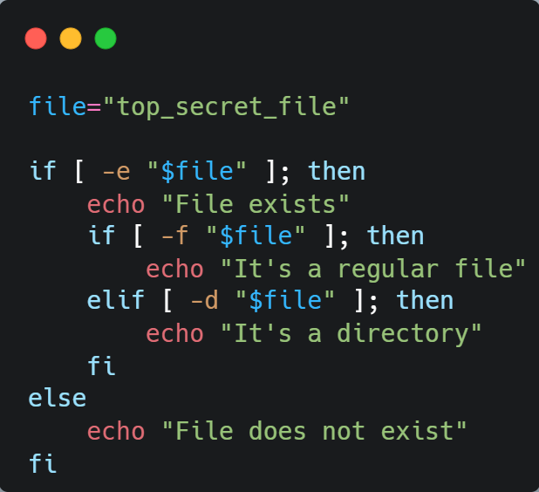
Strings
Files

Slide 44
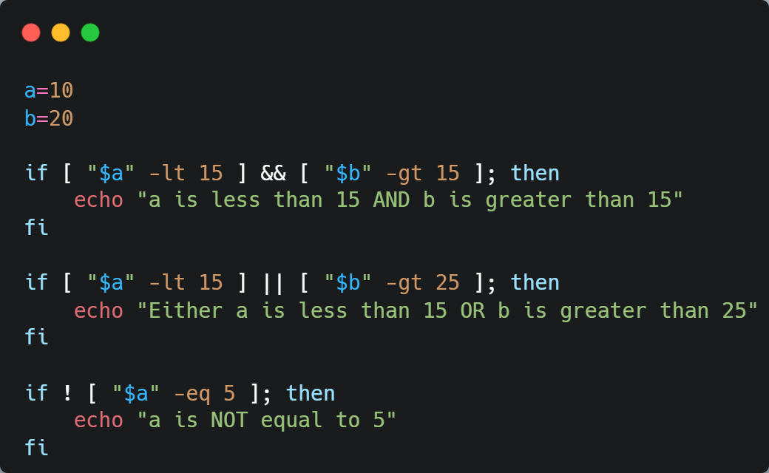
Logical Operators

Slide 45
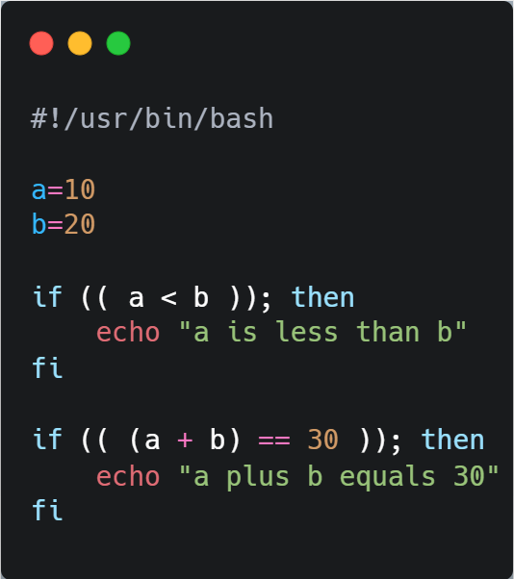
Arithmetic Operators

Slide 46
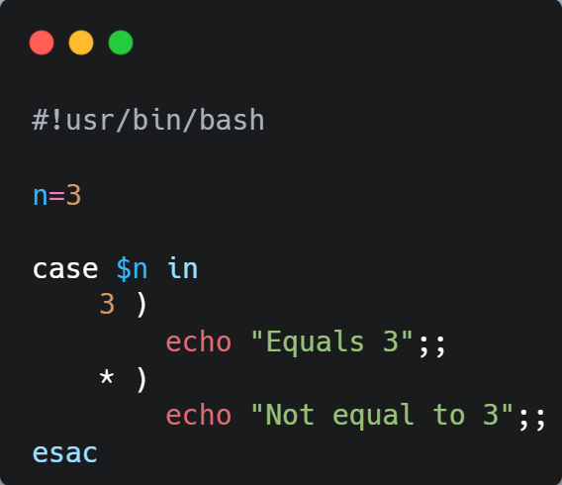
Cases

Slide 47
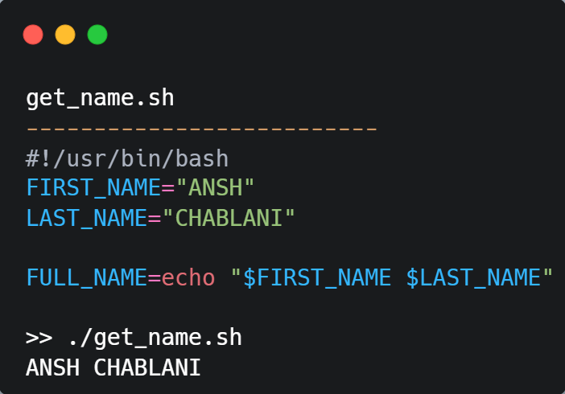
Variables

Slide 48
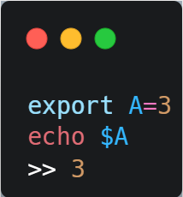
Export
Used to set variables

Slide 49
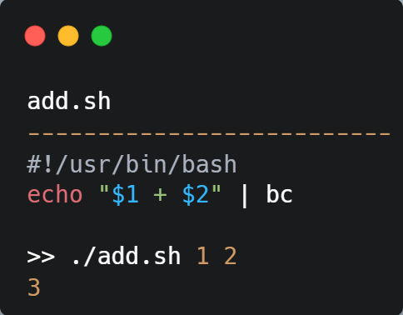
Command Line Arguments

Slide 50
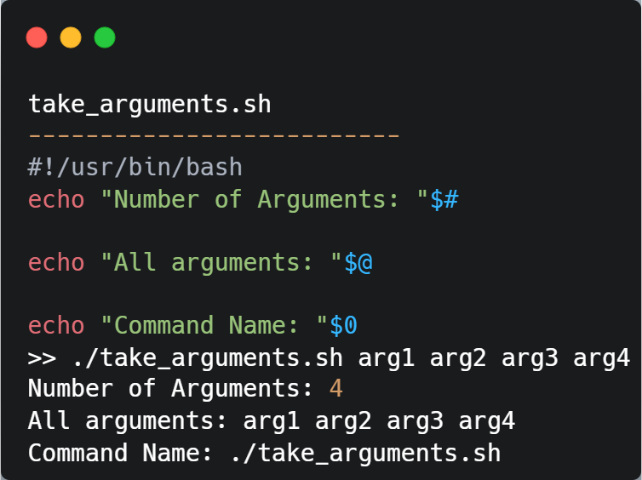

Slide 51

read
How do you take input?
Notes:
Give examples and give link to regex tutorials.

Slide 52
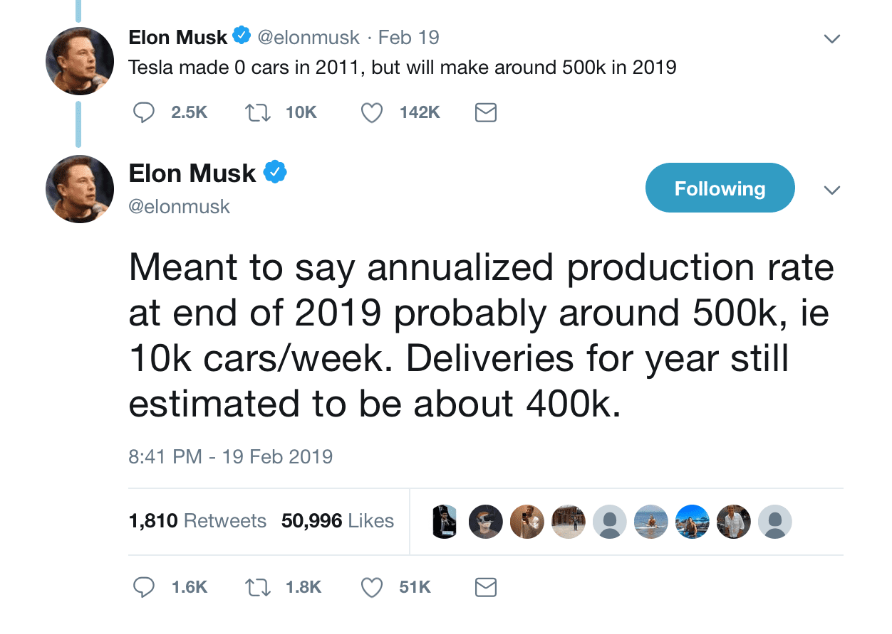
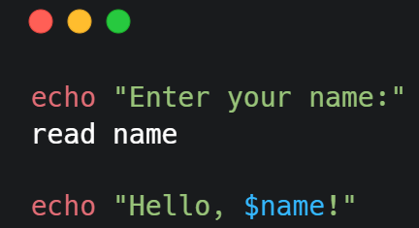
II finally found how to take user input in bash
Notes:
Go to terminal to show various ways to read in bash.

Slide 53

Regular Expressions
Let’s see this live in the terminal.
Notes:
Give examples in terminal and give link to regex tutorials.

Slide 54
bc
Notes:
Basic Calculator, switch to terminal to show

Slide 55
wc
Notes:
Word count, switch to terminal to show

Slide 56

Thank you

